Slide 1
Hands on Python Syntaxes
By Inderpreet Singh Walia

Slide 2
Data Structures
Data Structures are a way of organizing so that is can be accessed more efficiently depending upon the situation.
Data Structures are fundamentals of any programming language around which a program is built
Python helps to learn the fundamental of these data structures in a simpler way as compared to other programming languages.

Slide 3
Why Data Structures and Algorithms Are Important to Learn?
If you need to search your roll number in 20000 pages of PDF document (roll numbers are arranged in increasing order) how would you do that?
If you will try to search it randomly or in a sequential manner it will take too much time. You might get frustrated after some time.
You can try another solution which is given below…
Go to page no. 10000
If your roll no. is not there, but all other roll no. in that page are lesser than your than
Go to page no. 15000
Still if your roll no. is not there. but this time all other roll no. is greater than your.
Go to page no. 12500

Slide 4
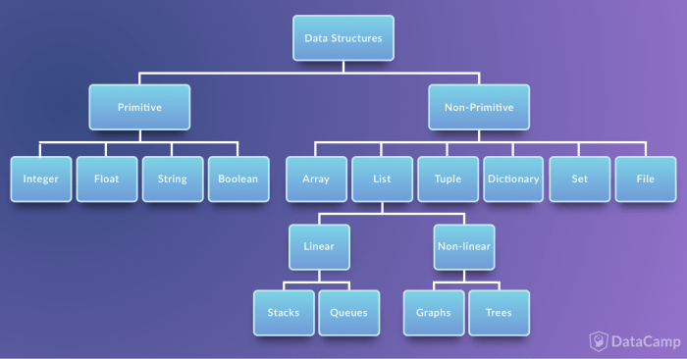
PRIMITIVE AND NON-PRIMITIVE DATA STRUCTURES

Slide 5
STRINGS
Strings are used to record the text information such as name. In Python, Strings act as “Sequence” which means Python tracks every element in the String as a sequence. This is one of the important features of the Python language.
For example, Python understands the string "hello' to be a sequence of letters in a specific order which means the indexing technique to grab particular letters (like first letter or the last letter).

Slide 6
Lists
Earlier, while discussing introduction to strings we have introduced the concept of a sequence in Python. In Python, Lists can be considered as the most general version of a "sequence". Unlike strings, they are mutable which means the elements inside a list can be changed.
Lists are constructed with brackets [] and commas separating every element in the list.

Slide 7
Advantages of Data Structures
1) Allows easier processing of data.
2) It allows information stored on disk very efficiently.
3) These are necessary for designing an efficient algorithm.
4) It provides management of databases like indexing with the help of hash tables and arrays.
5) We can access data anytime and anywhere.
6) It is secure way of storage of data.
7) Graphs models real life problems
8) It allows processing of data on software system

Slide 8
Disadvantages of Data Structures
It is applicable only for advanced users.
If any issue occurs it can be solved only by experts.
Slow access in case of some data types

Slide 9
Homework Question
1.

